Slide 1
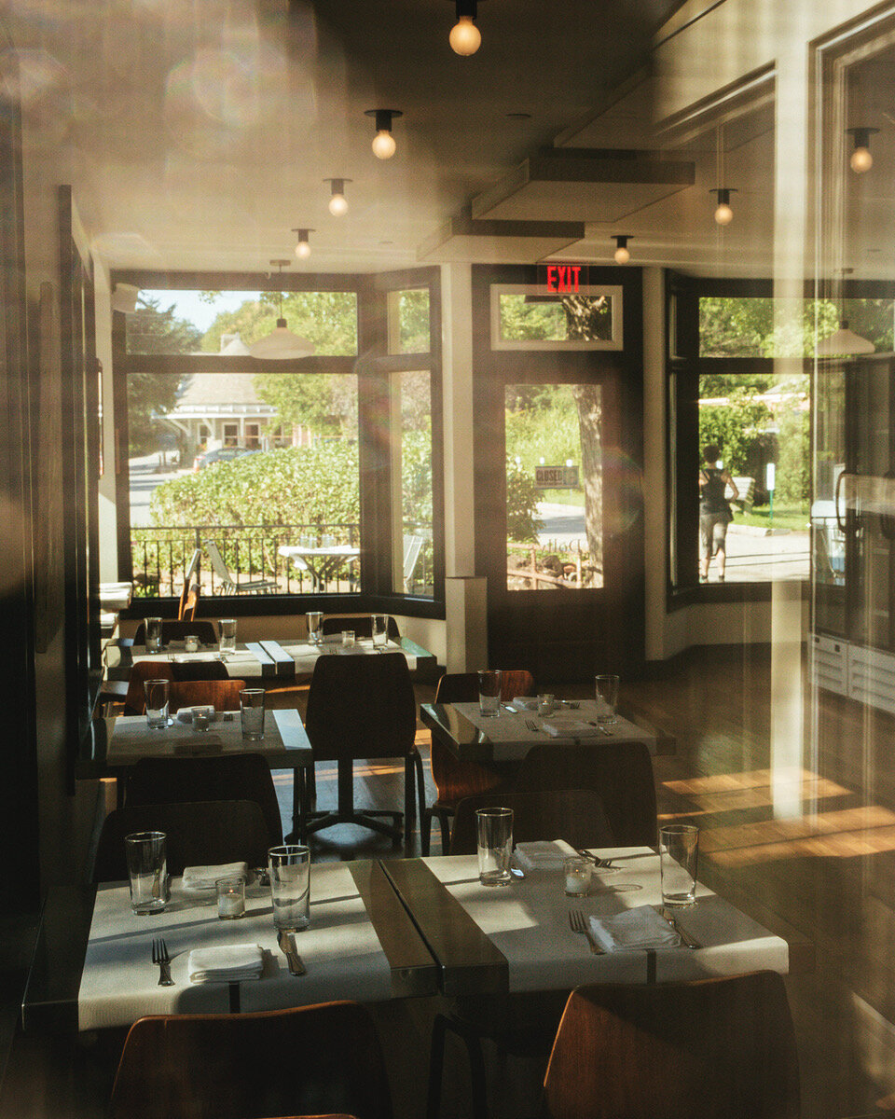
PROJECT PRESENTATION ON DEVELOPMENT AND TESTING
Developed By - Team Avengers

Slide 2
HOTEL MANAGEMENT SYSTEM - DEVELOPMENT

Slide 3
SATURN
TRAINED & GUIDED BY SARAVANAN R
TEAM MEMBERS | EMPLOYEE ID
SAHANA H. M. | 300378
BHAVYA Y.M. | 300377
NAMRATA RATI | 300369
SHUBHAM KUMAR | 300362
SAGAR SHETTY | 300371

Slide 4
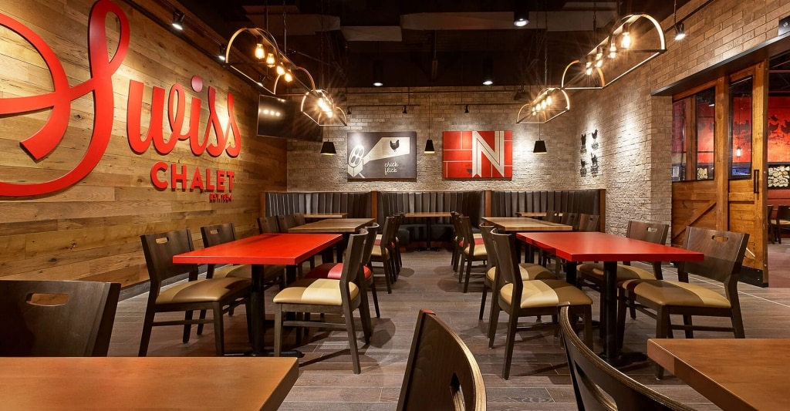
INTRODUCTION
Web based management system
More advantageous compared to Manual system.
Helps us to manage and control all the functionalities of hotel automatically.
Keeps the record of all the food items along with its price and category.
Makes the system more versatile and user friendly.

Slide 5
PROJECT ENVIRONMENT
DATABASE : Oracle
OPERATING SYSTEM : Windows 10
PROGRAMMING LANGUAGE: J2EE, HTML & CSS

Slide 6
PRODUCT FEATURES
LOG IN
VIEW MENU
ADD MENU
SEARCH MENU
LOG OUT
EDIT AND DELETE MENU

Slide 7
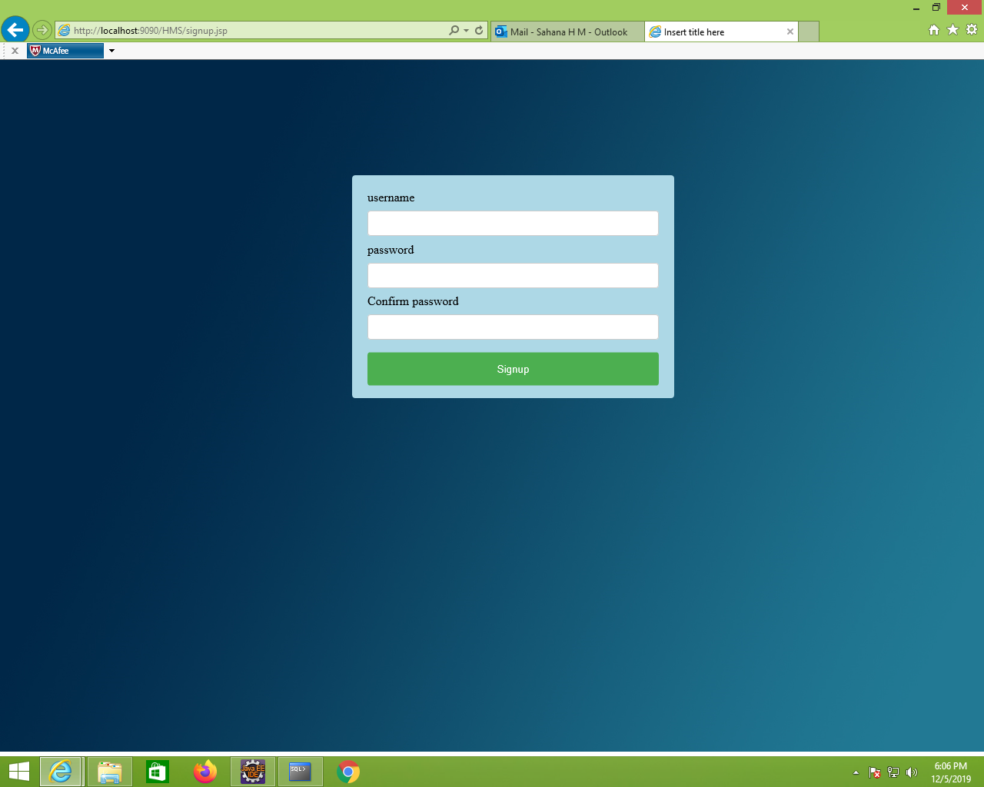
SIGN UP PAGE

Slide 8
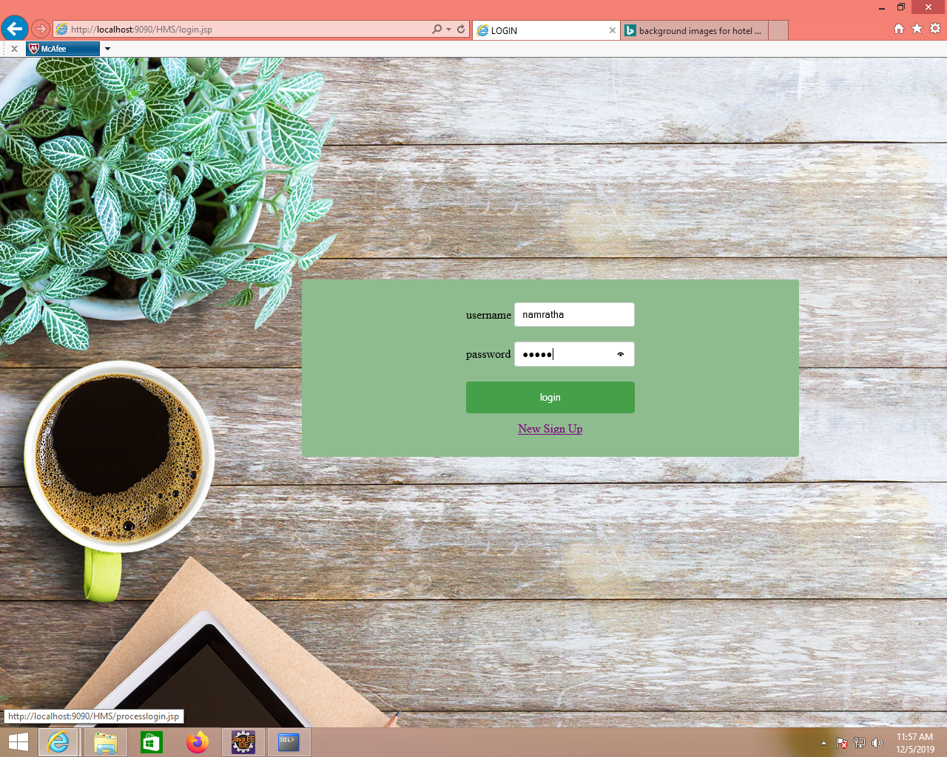
LOGIN PAGE

Slide 9
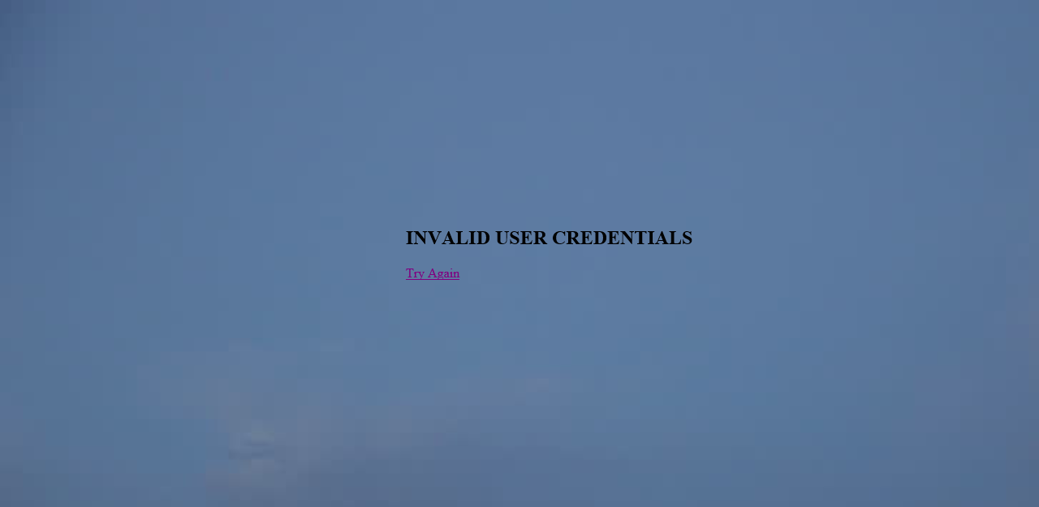
INVALID LOGIN PAGE

Slide 10
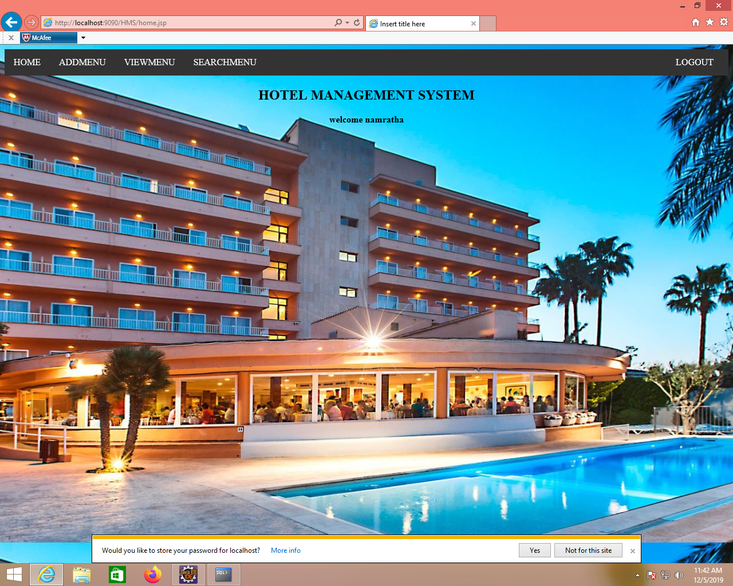
HOME PAGE

Slide 11
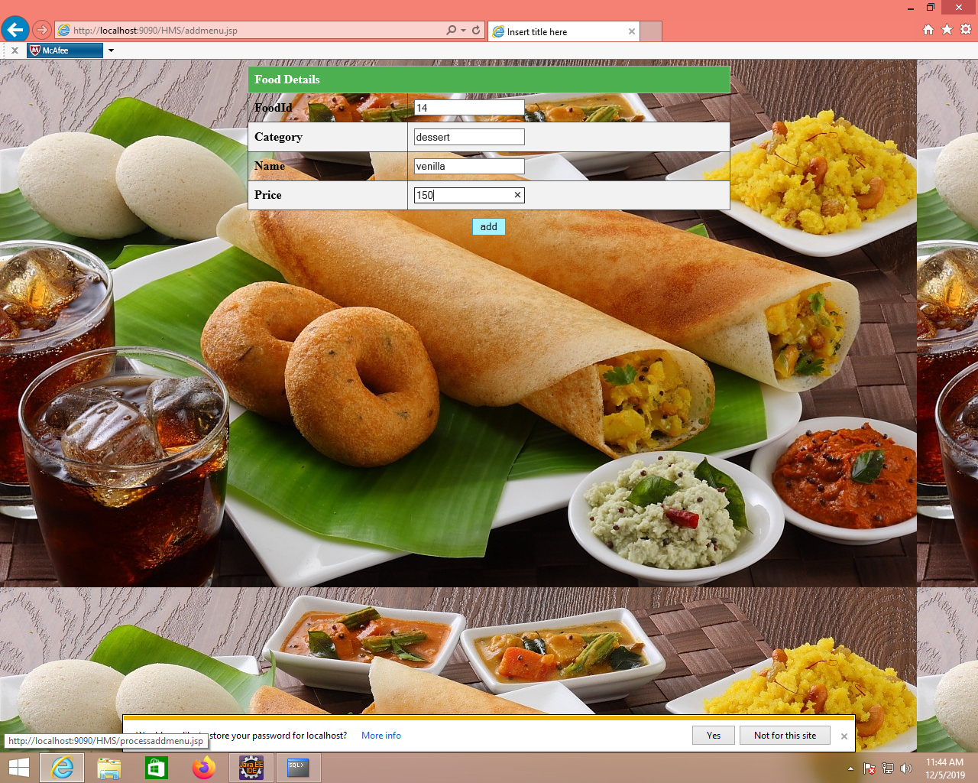
ADD MENU PAGE

Slide 12
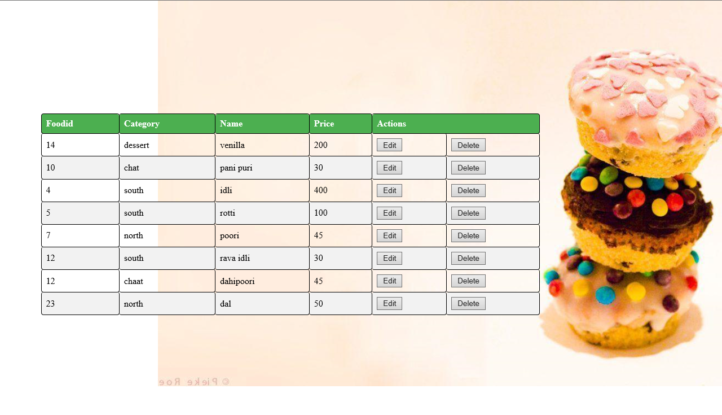
VIEW MENU PAGE

Slide 13
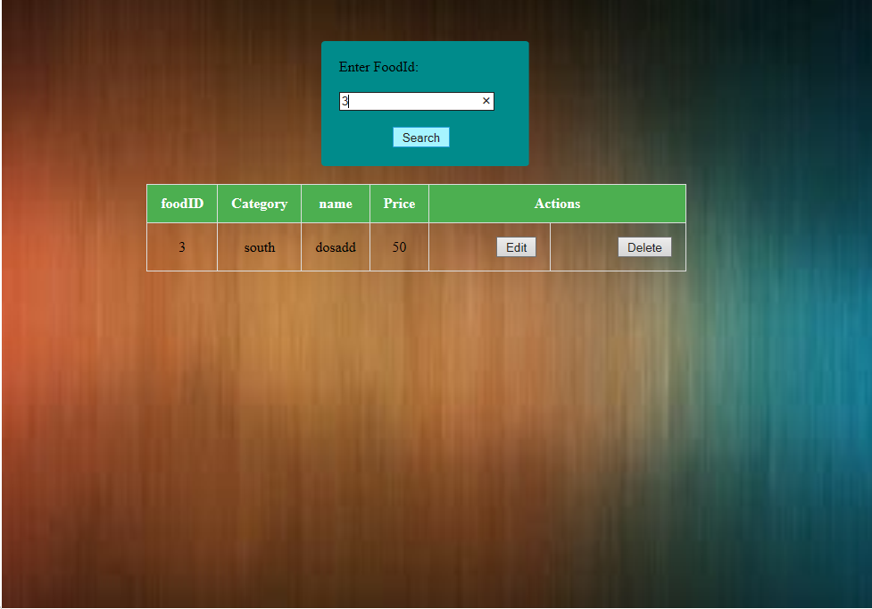
VALID SEARCH PAGE

Slide 14

INVALID SEARCH PAGE

Slide 15
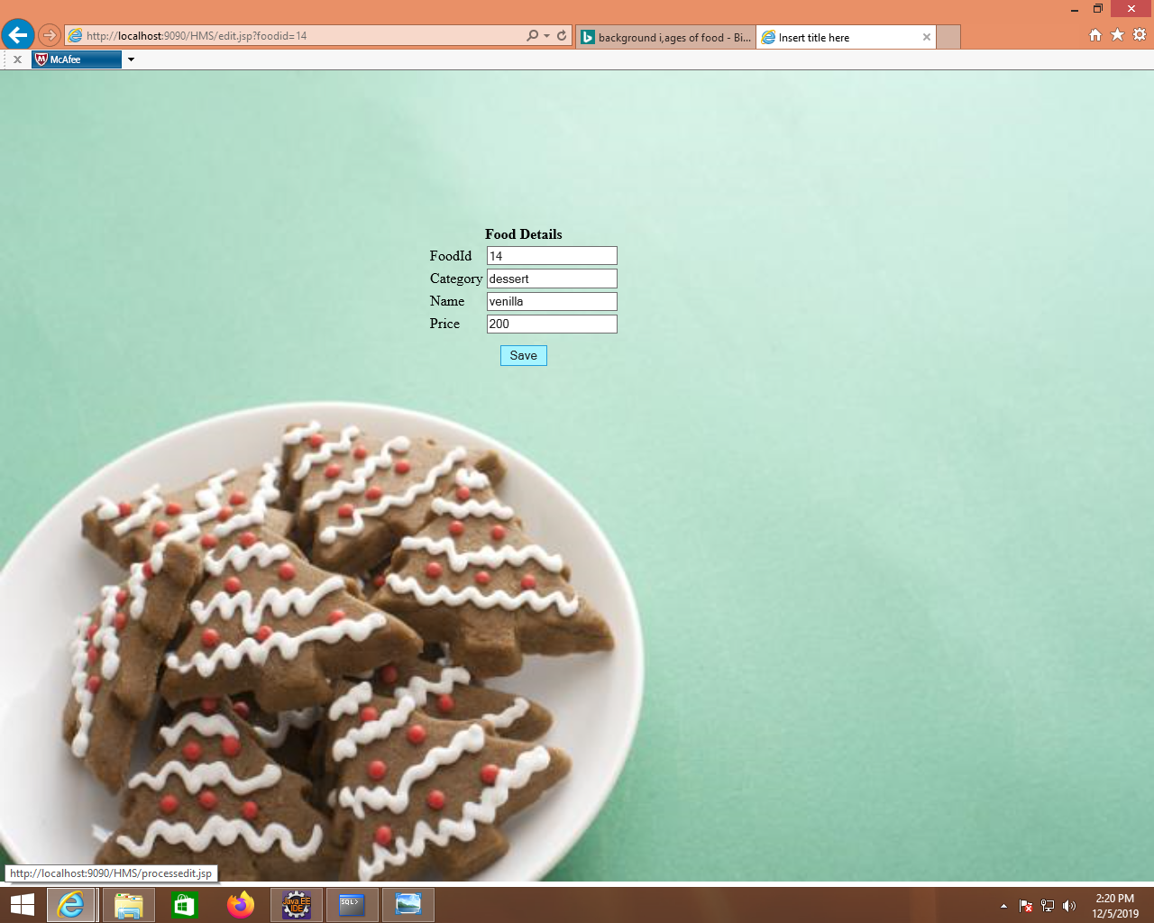
EDIT MENU PAGE

Slide 16
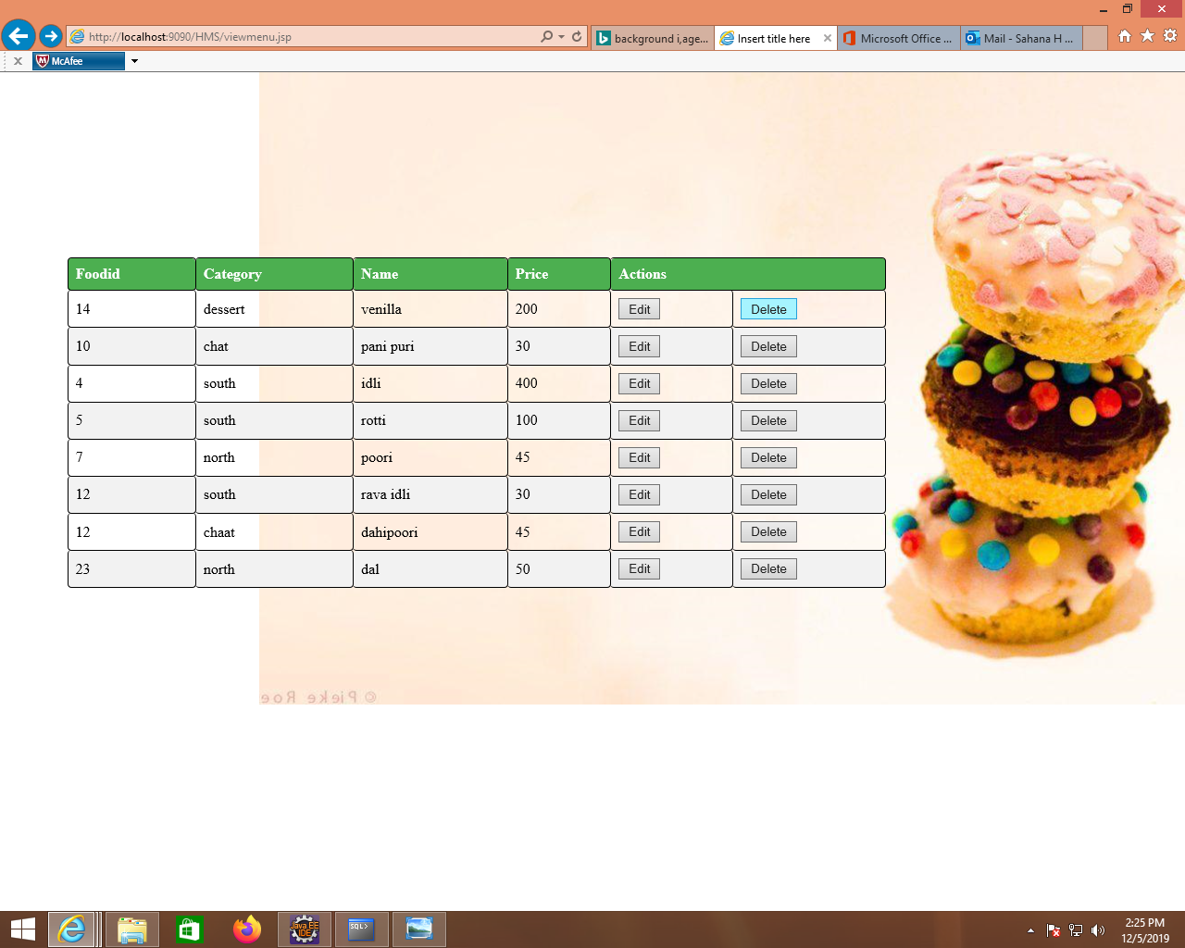
DELETE MENU

Slide 17
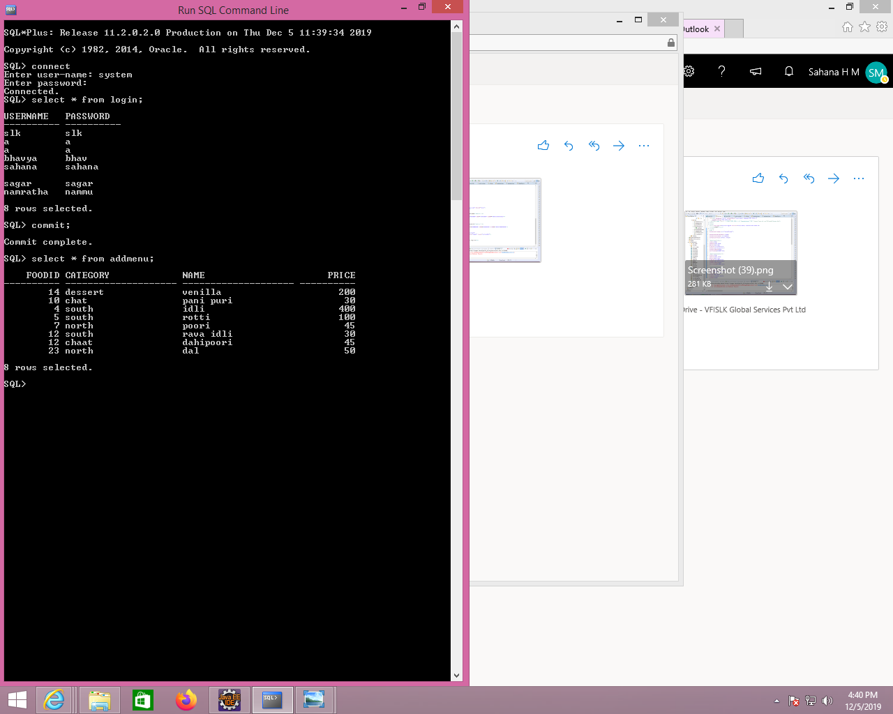
ORACLE TABLE DATA

Slide 18
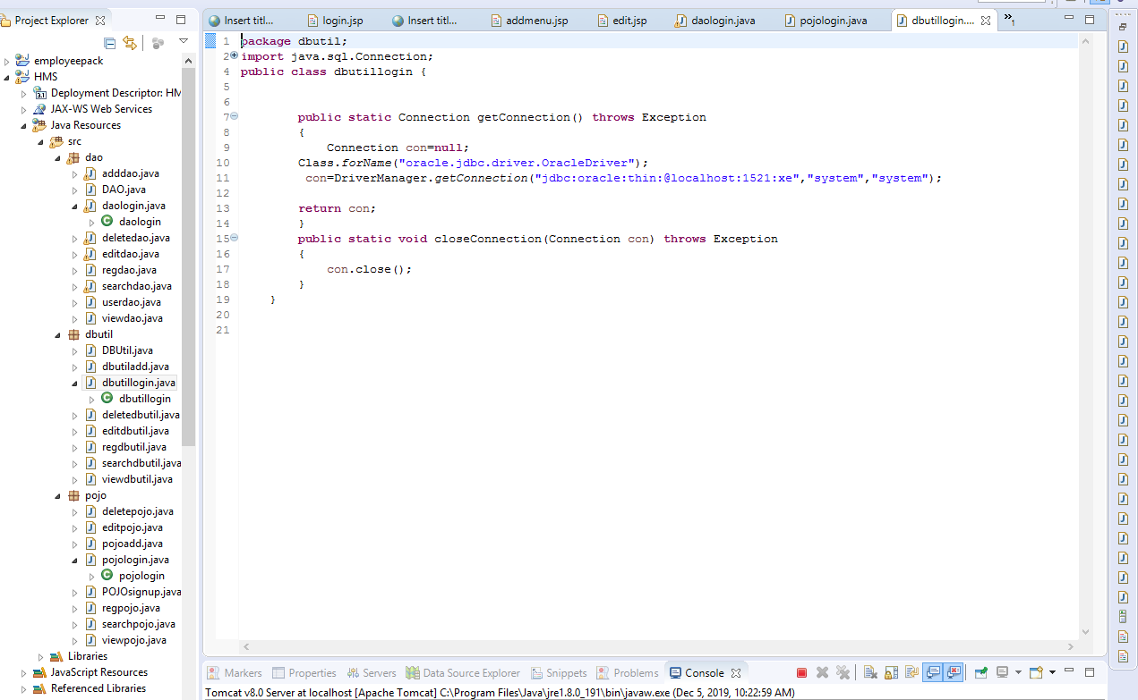
DBUTIL CLASS – SAMPLE CODE

Slide 19
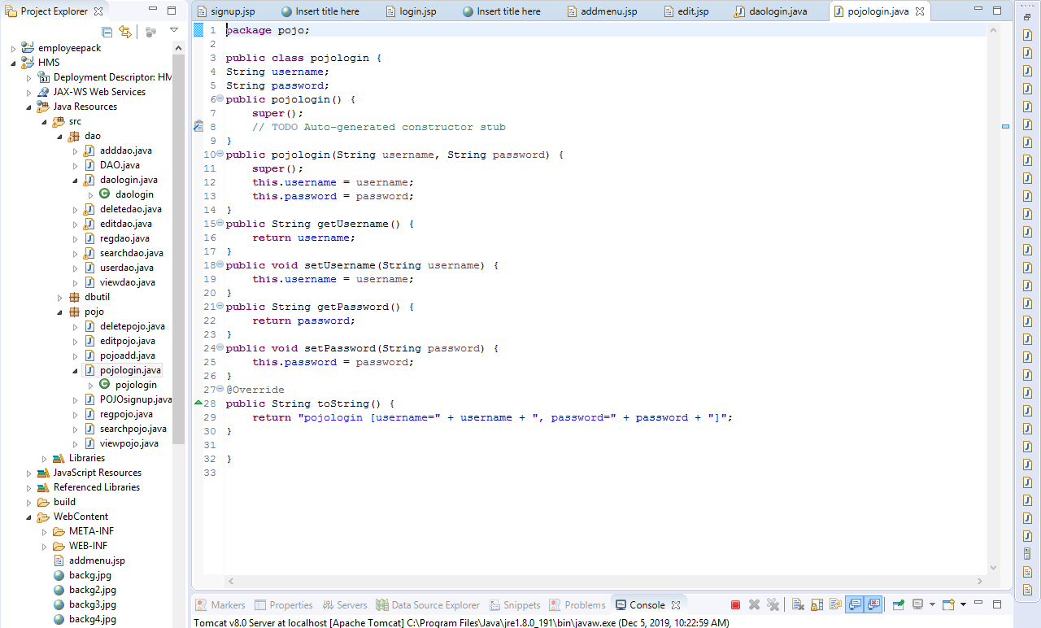
POJO CLASS – SAMPLE CODE

Slide 20
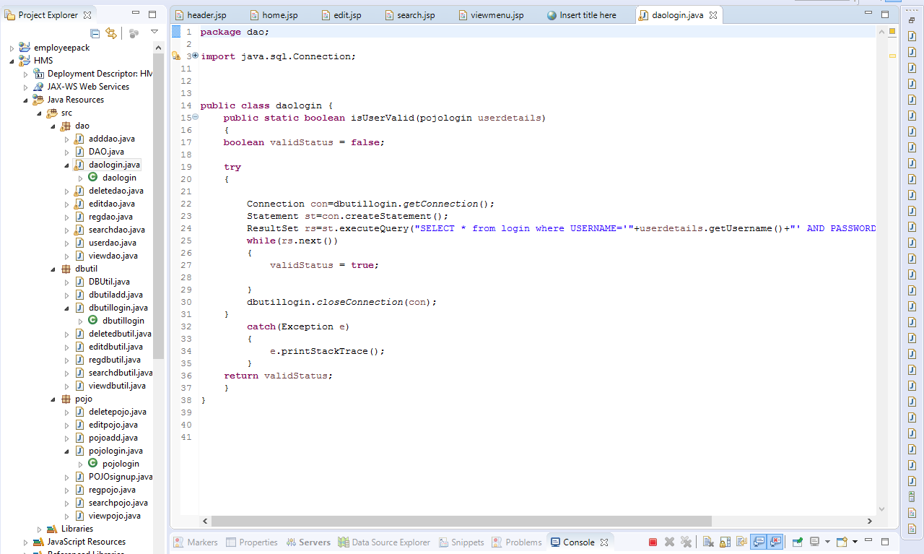
DAO CLASS – SAMPLE CODE

Slide 21
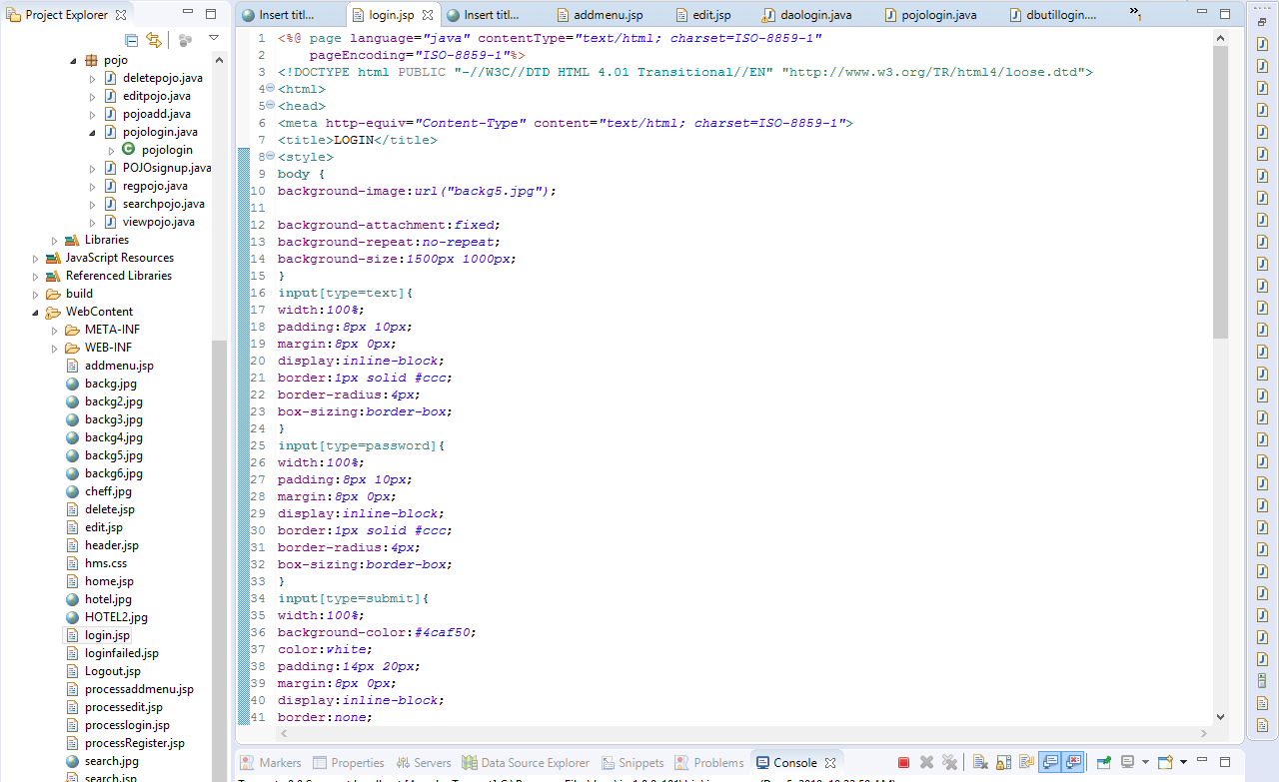
JSP SAMPLE CODE 1

Slide 22
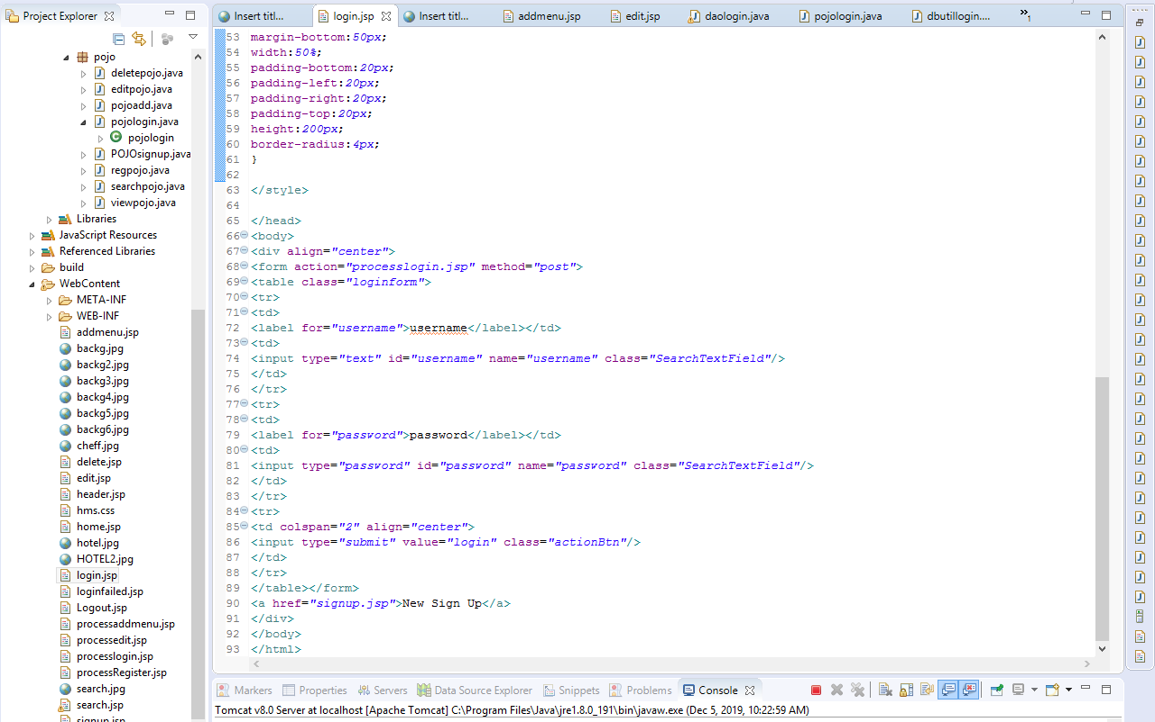
JSP SAMPLE CODE 2

Slide 23
Source Code
https://github.com/SahanaHM/HMS
https://github.com/Bhavyaym/Hotel-management-system
https://github.com/SagarShetty96/Hotel-management-system
https://github.com/shubh1A/Hotel-management-system
https://github.com/Namrata-1997/HMS

Slide 24
THANKS
THANK YOU

